Slide 1
How to design a representative data visualization in research paper?
Herdiantri Sufriyana, MD, PhD
Graduate Institute of Biomedical Informatics
College of Medical Sciences and Technology
Taipei Medical University
Department of Medical Physiology
Faculty of Medicine
Universitas Nahdlatul Ulama Surabaya

Slide 2
Why matters in a research paper?
People (e.g. editors, reviewers) is busy (read: inherently lazy)
More effective for some kind of information
Word efficient
Visually appealing (a subliminal message that you’re pro)

Slide 3
Data viz: research paper vs. infographic
Research paper
Infographic
Deliver it as an argument
Ideally avoid confirmatory bias
Do it if only a message is not well-described in the main text
Target scientific audience
Be less oriented to visual appeal
Deliver it as a persuasion
Intentionally exploit confirmatory bias
Do it to convey a message (probably the most common way)
Target layperson
Be more oriented to visual appeal

Slide 4

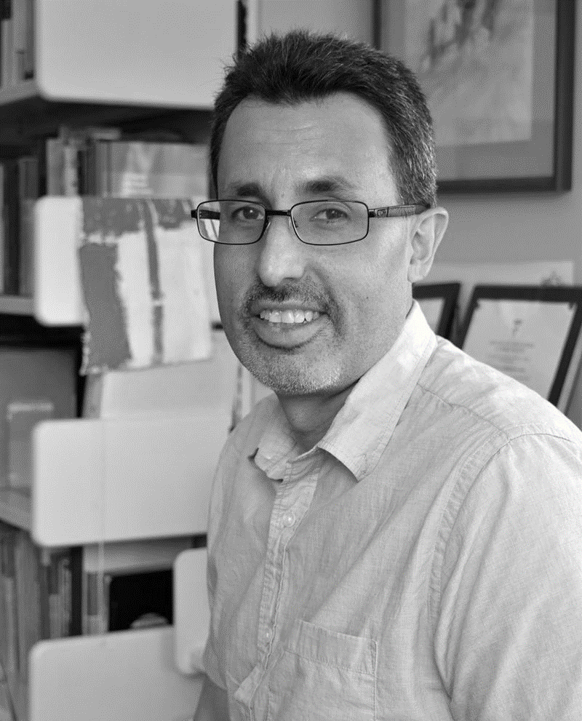
12 Principles of Data Visualization
Originally proposed by Rafael Irizarry
Irizarry, R. A. (2020). Chapter 11: Data visualization principles. In: Introduction to data science: Data analysis and prediction algorithms with R. https://rafalab.github.io/dsbook/data-visualization-principles.html

Slide 5
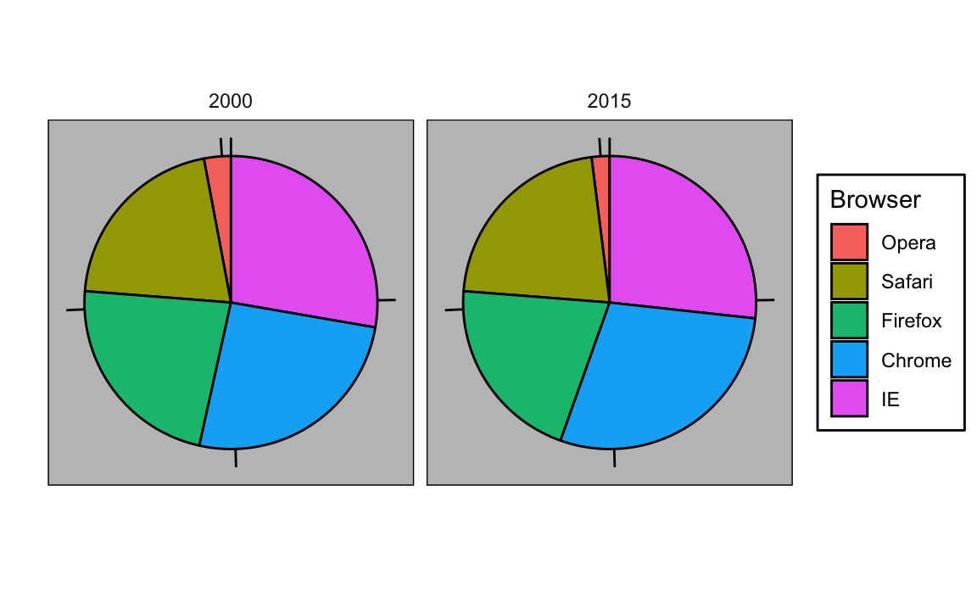
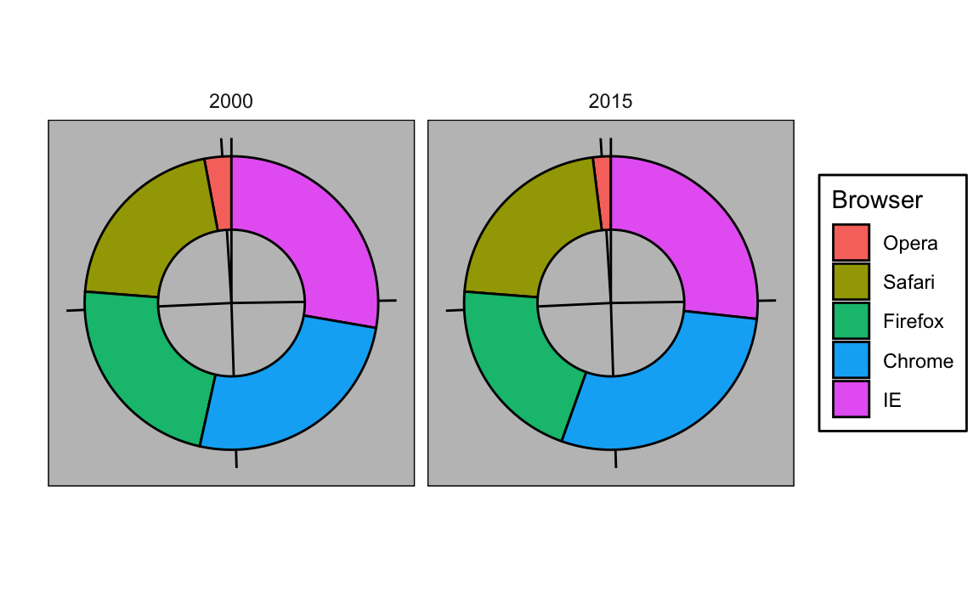
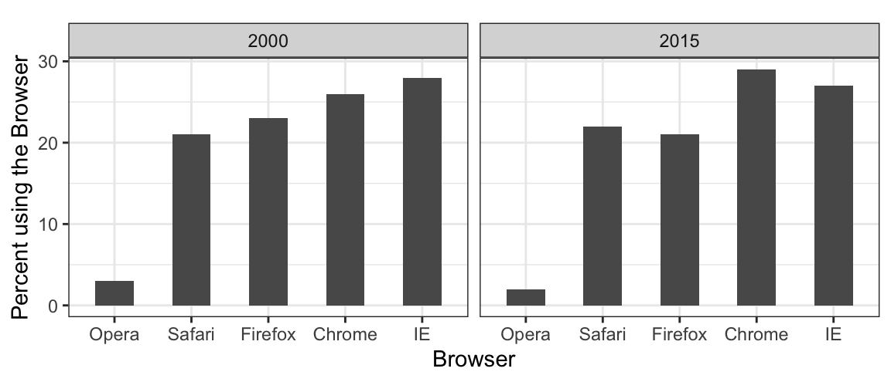
#1 Encoding data using visual cues
❌
Don’t use angle and area
Pie/ donut charts
Bar plot
✅
Use length and position

Slide 6
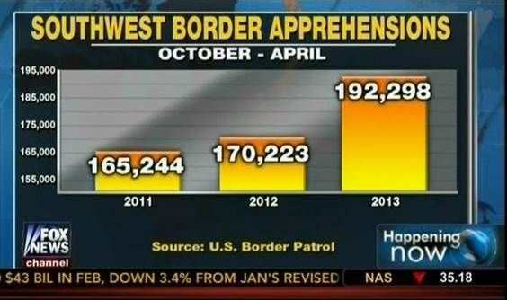
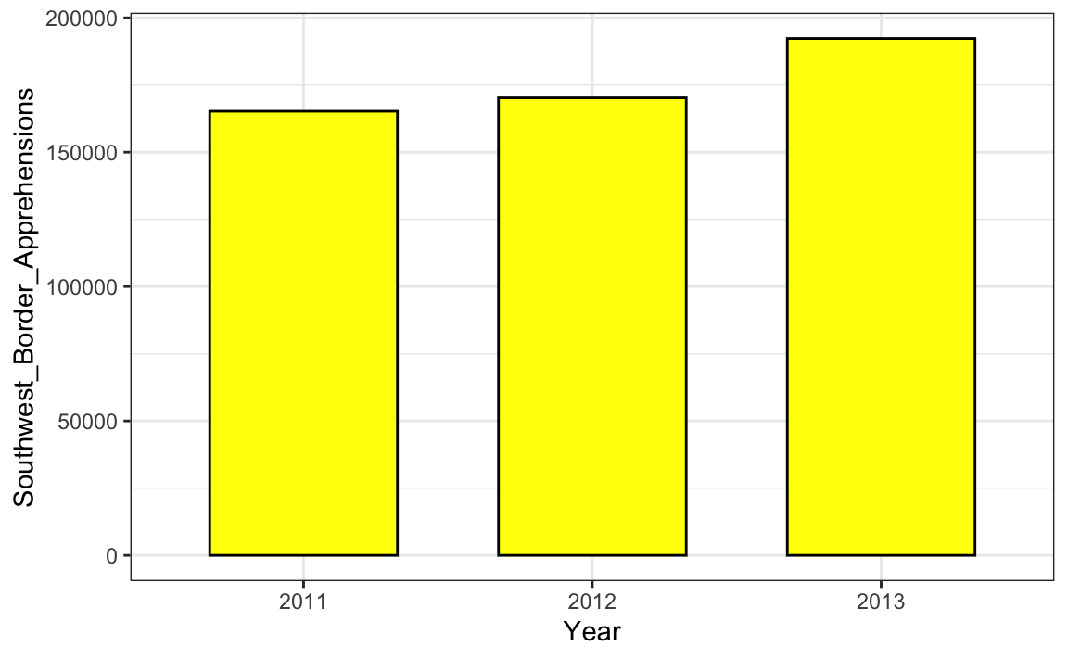
#2 Know when to include 0
Include 0 when using length as a main visual cue
❌
✅
Bar plot

Slide 7
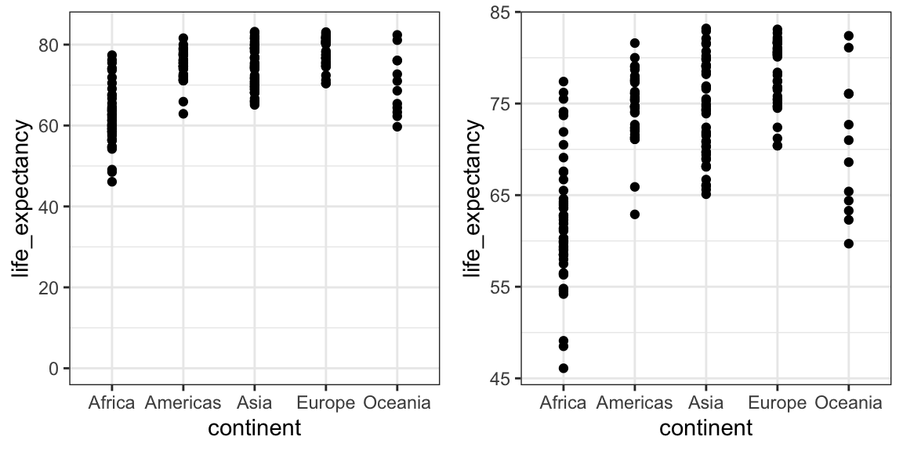
#2 Know when to include 0
Don’t include 0 when using position as a main visual cue
❌
✅
Point plot
Comparison between groups relative to within-group variability

Slide 8
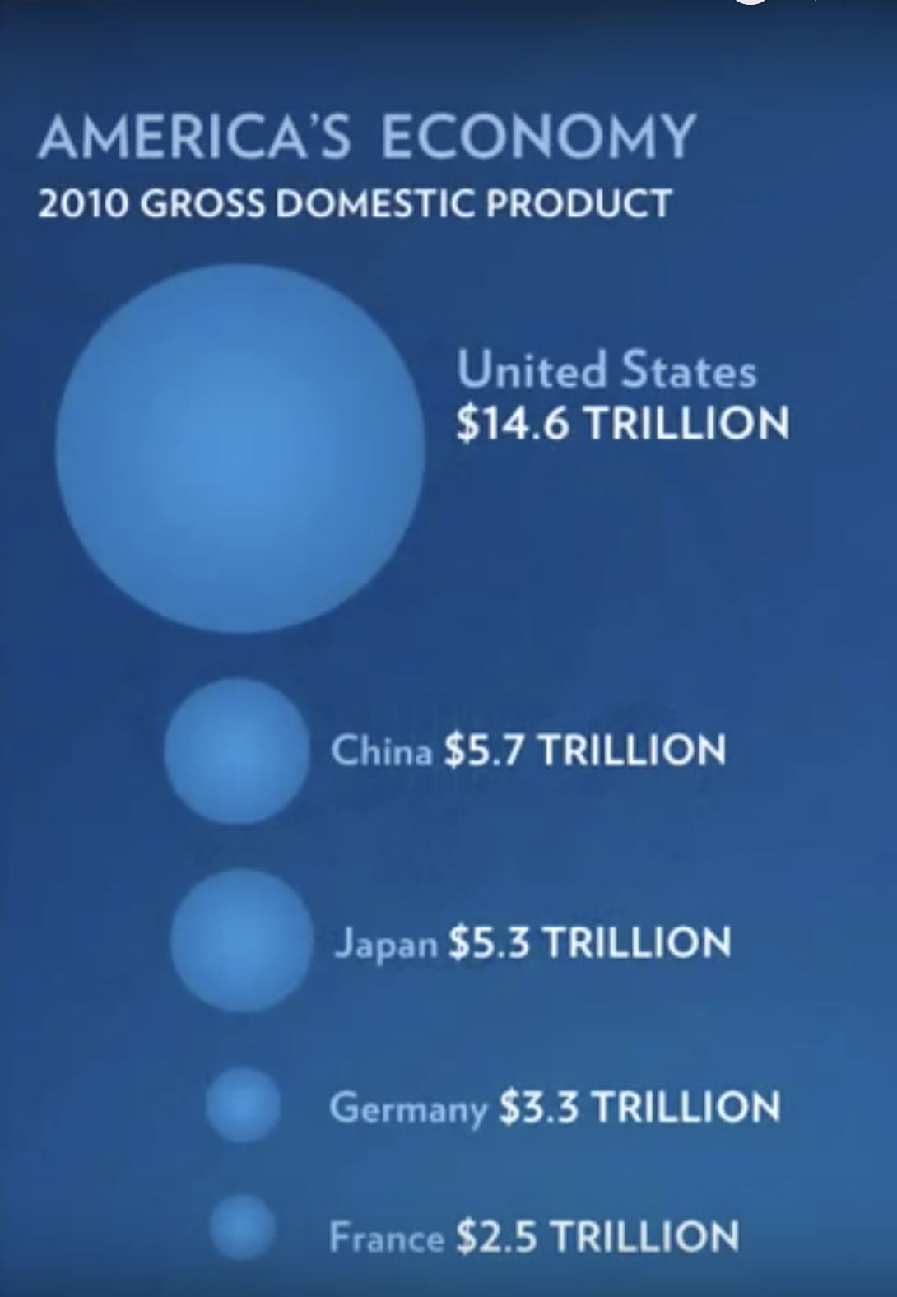
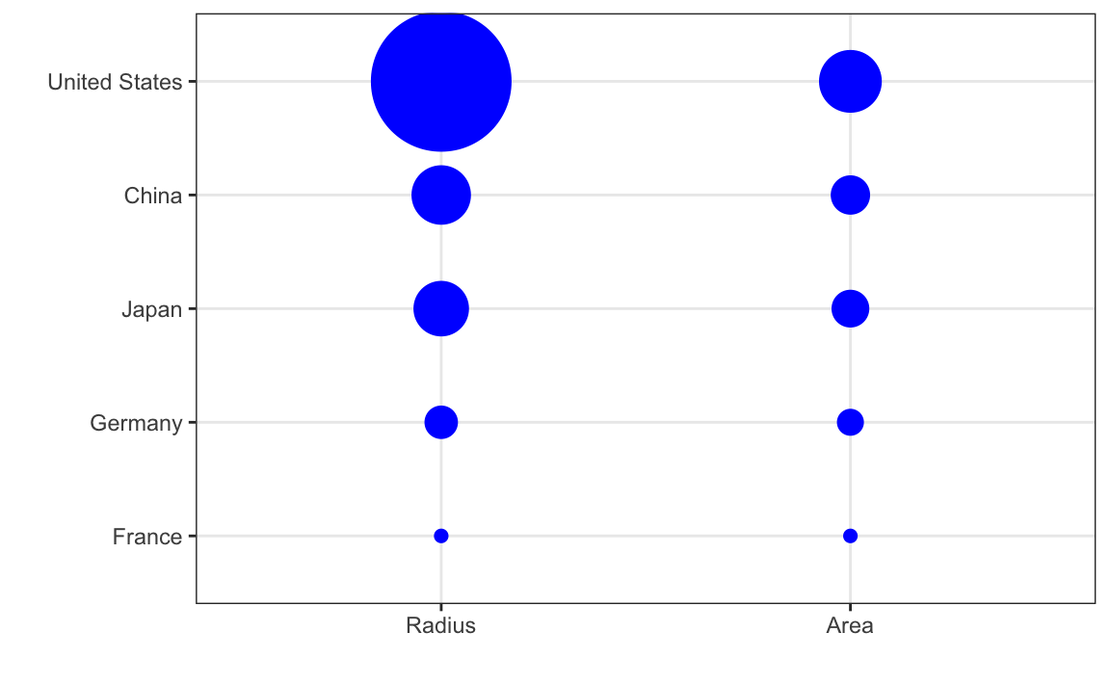
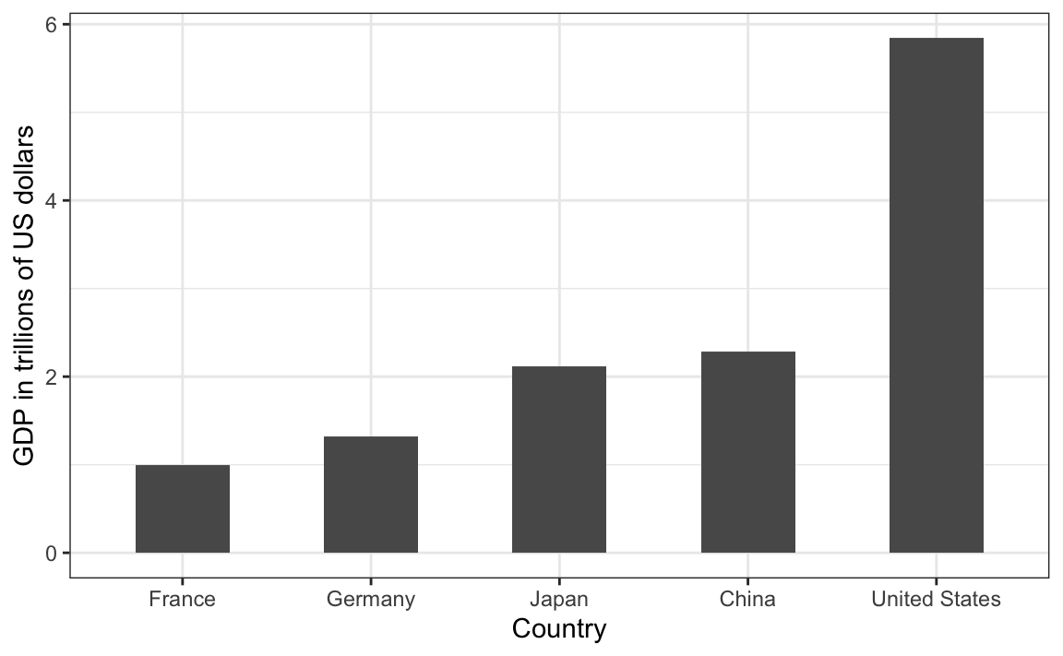
#3 Do not distort quantities
Point plot
❌
✅
Bar plot
❌
✅

Slide 9
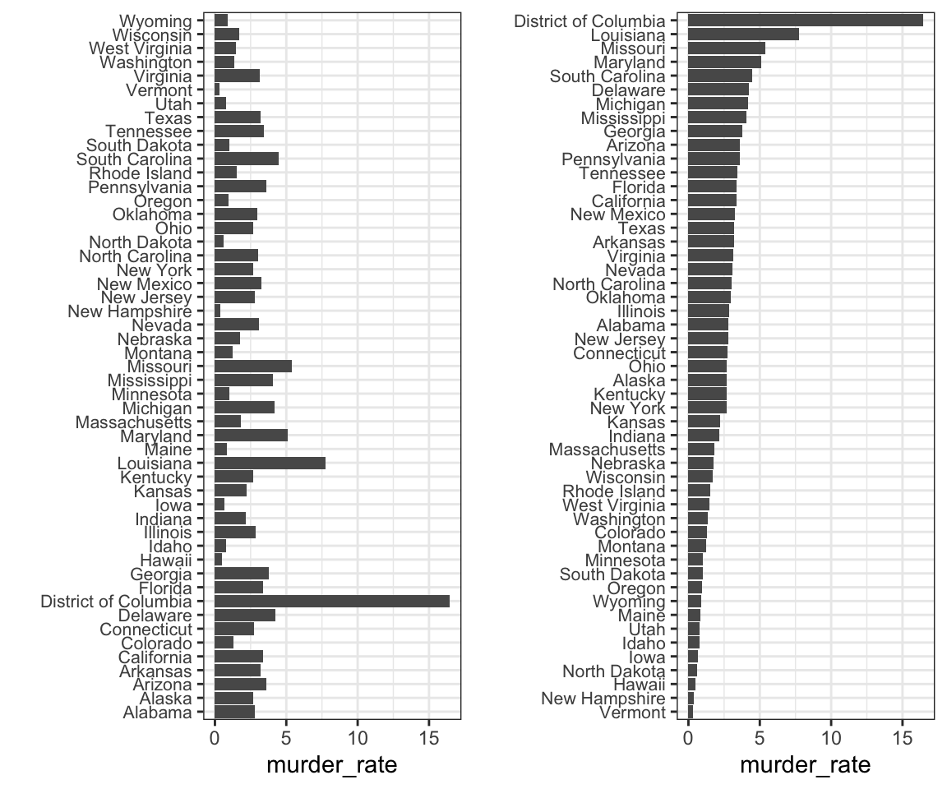
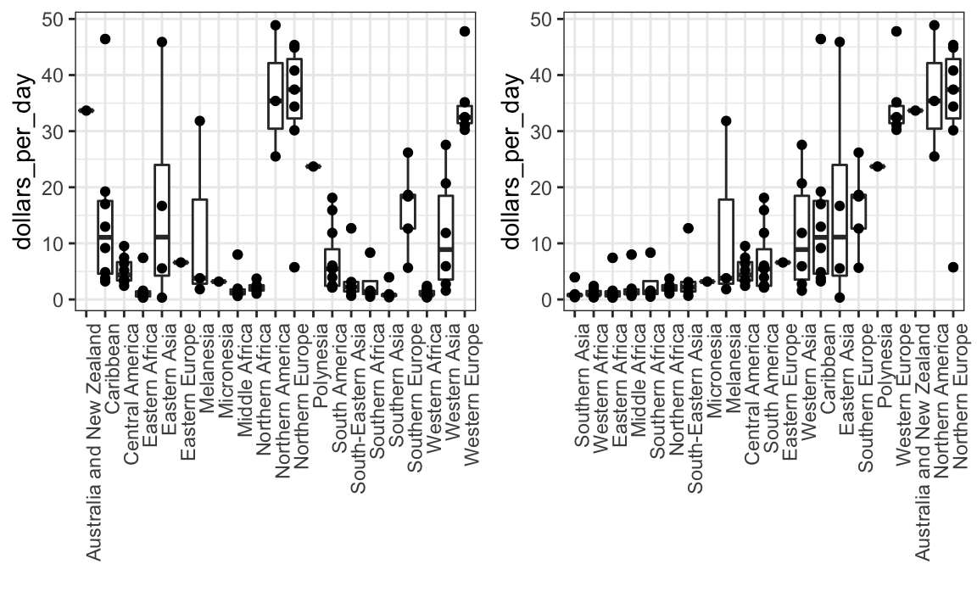
#4 Order categories by a meaningful value
Bar plot
Box plot + point plot
❌
✅
❌
✅

Slide 10
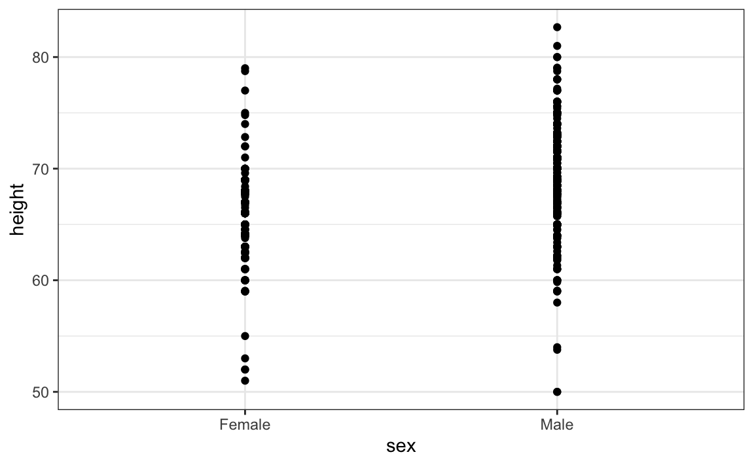
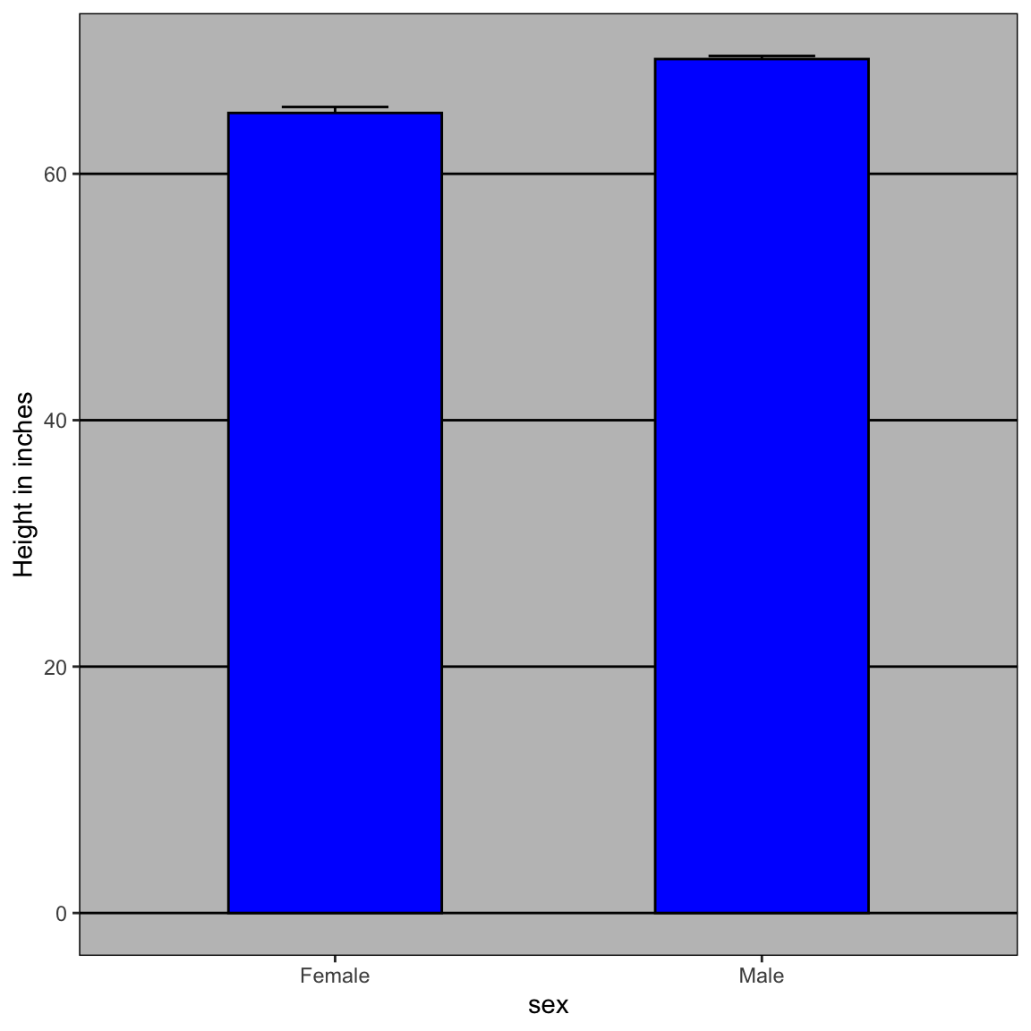
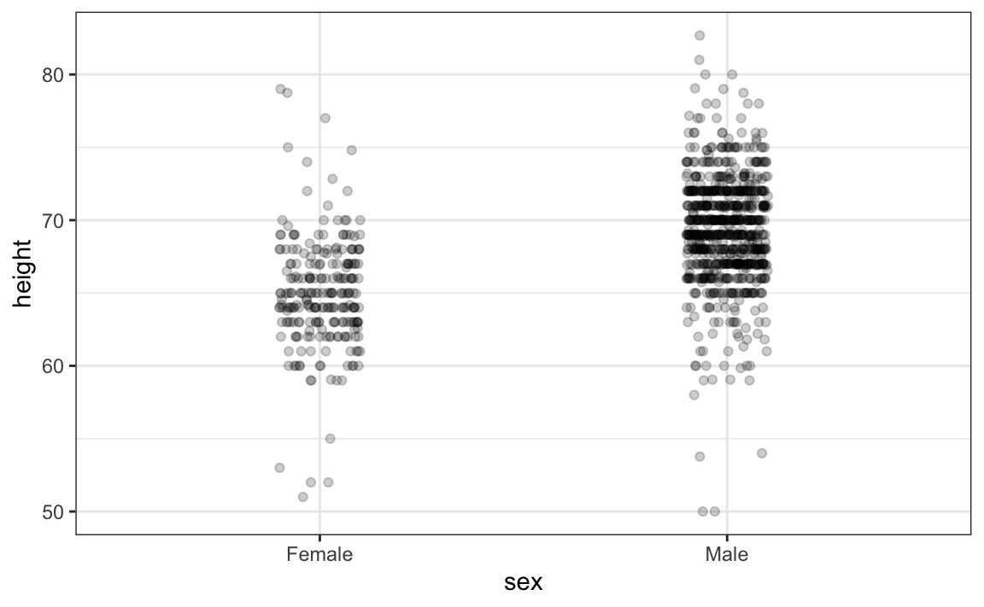
#5 Show the data
Point plot
Jitter plot
Bar plot

Slide 11
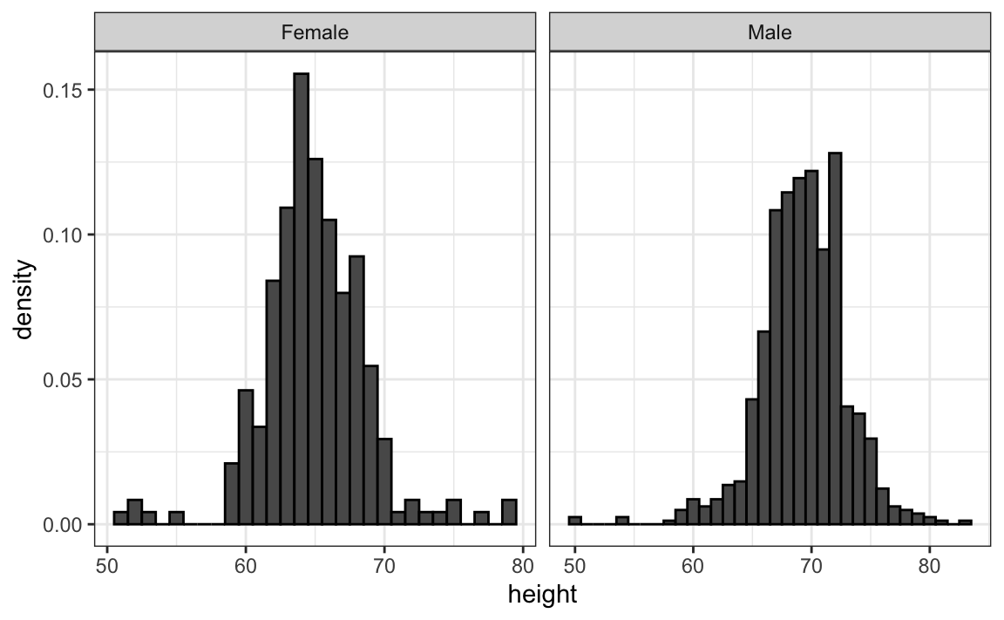
#6 Ease comparisons
Summarize points and use common axes
Jitter plot
Histogram

Slide 12
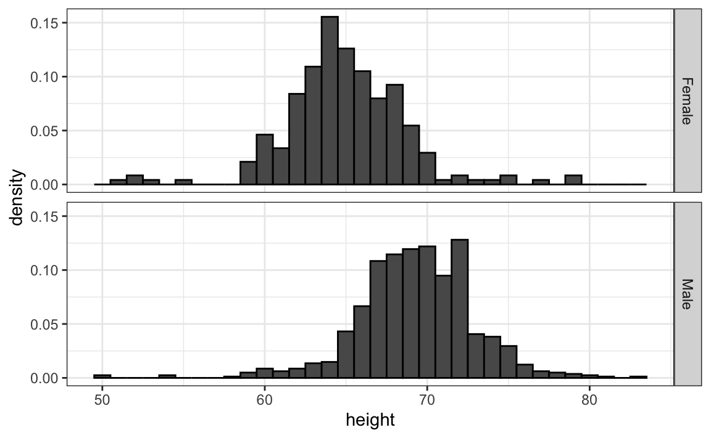
#6 Ease comparisons (2)
Align plots vertically to see horizontal changes and horizontally to see vertical changes
Histogram
Histogram

Slide 13
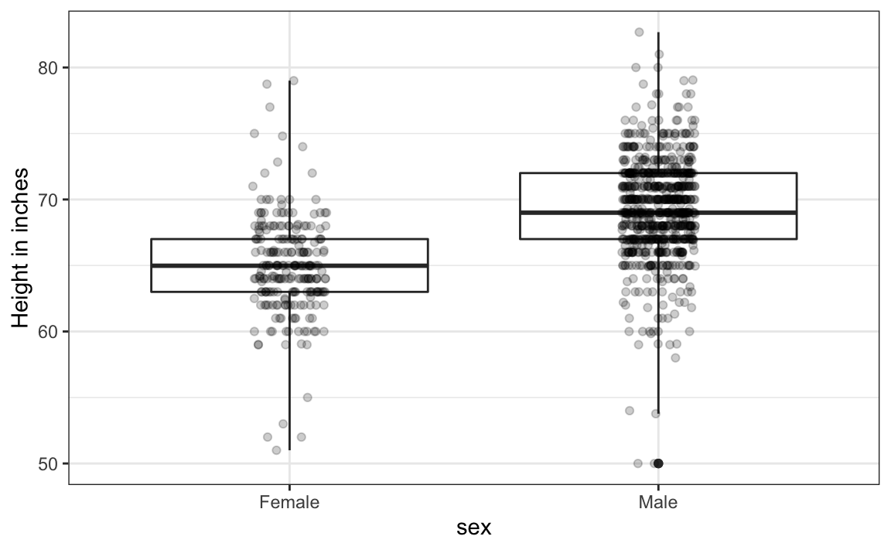
#6 Ease comparisons (3)
Summarization distribution and show the data
Jitter plot
Box plot + jitter plot

Slide 14
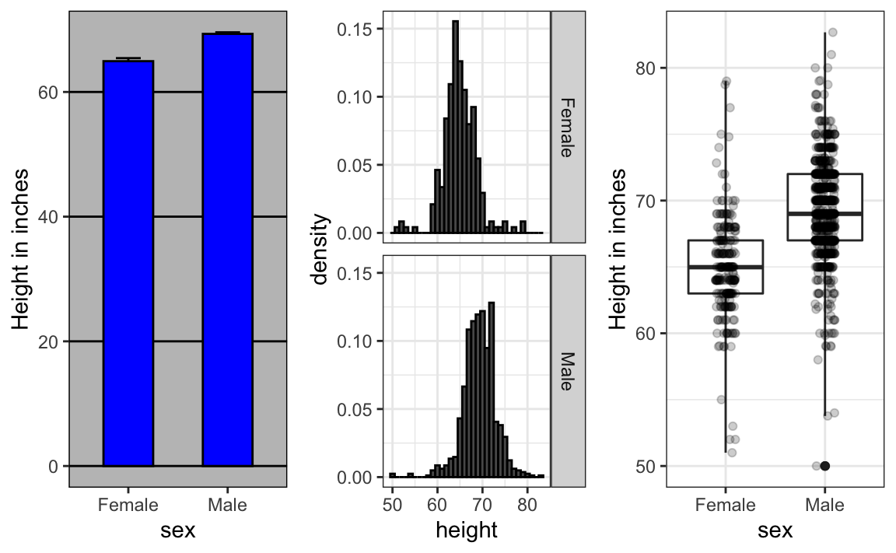
#6 Ease comparisons (4)
Box plot + jitter plot
Bar plot
Histogram
Show number only
Describe distribution

Slide 15
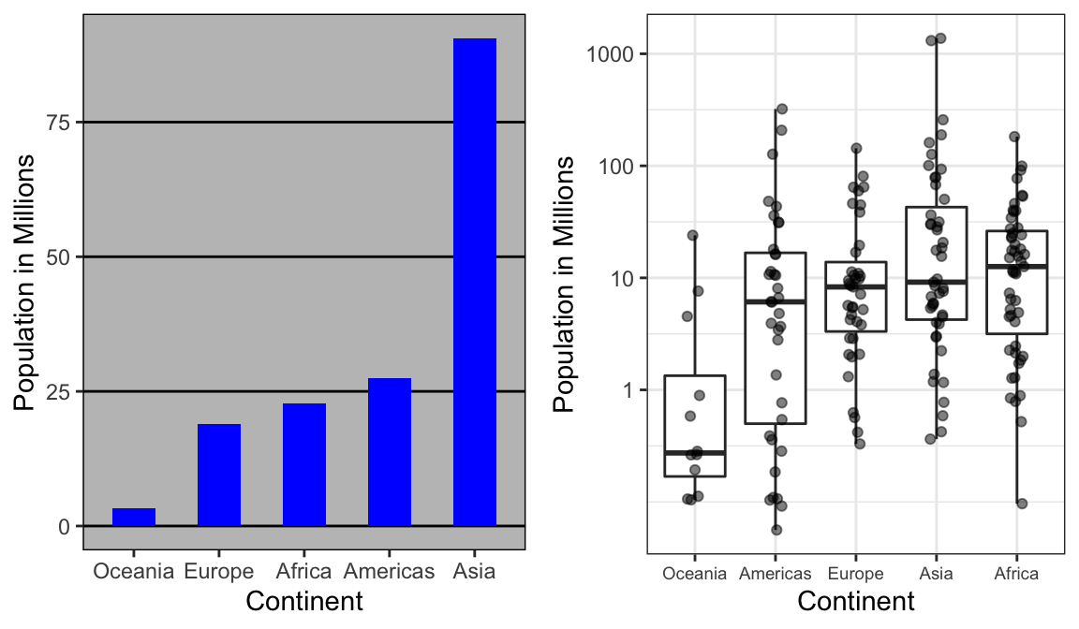
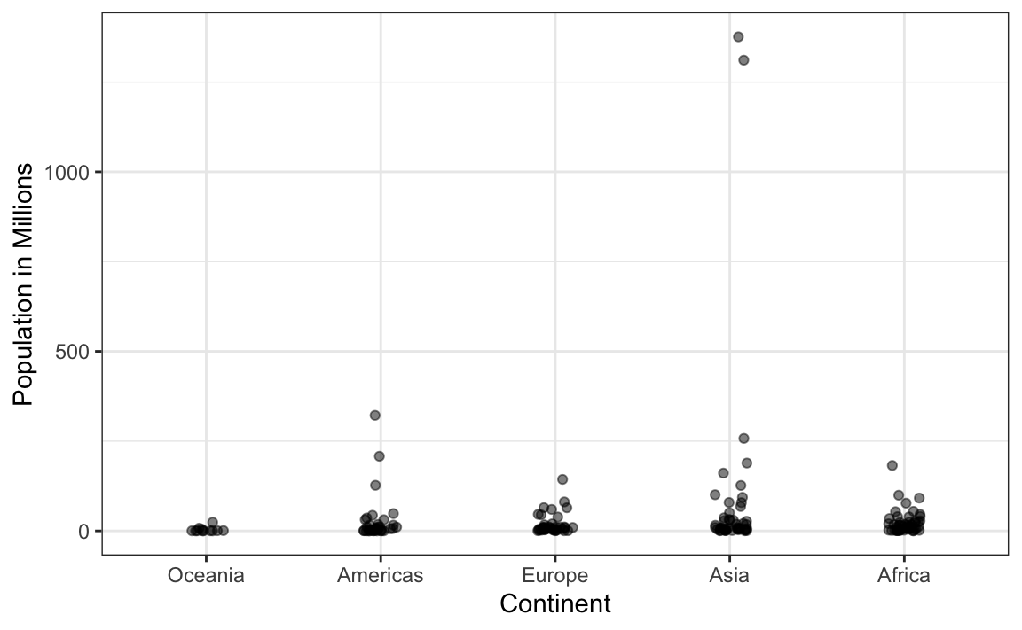
#6 Ease comparisons (5)
Consider transformation
China
India
log₁₀
Box plot + jitter plot

Slide 16
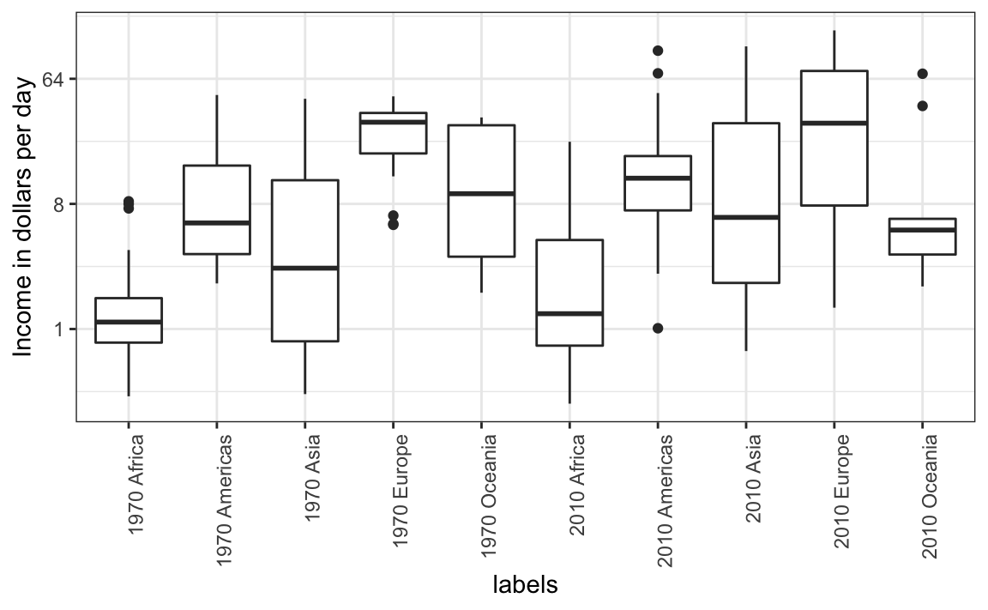
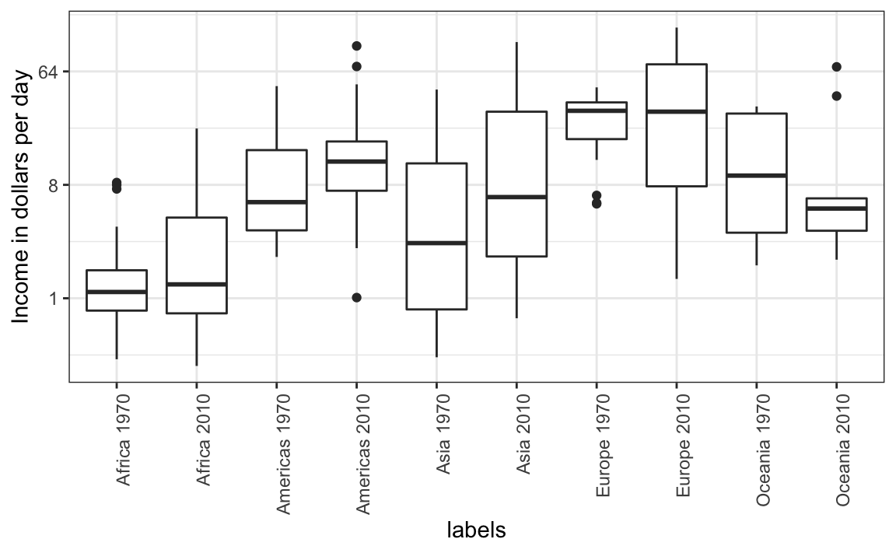
#6 Ease comparisons (6)
Visual cues to be compared should be adjacent
1970 Africa
1970 America
1970 …
2010 Africa
2010 America
2010 …
1970 Africa
2010 Africa
1970 America
2010 America
Box plot
Box plot

Slide 17
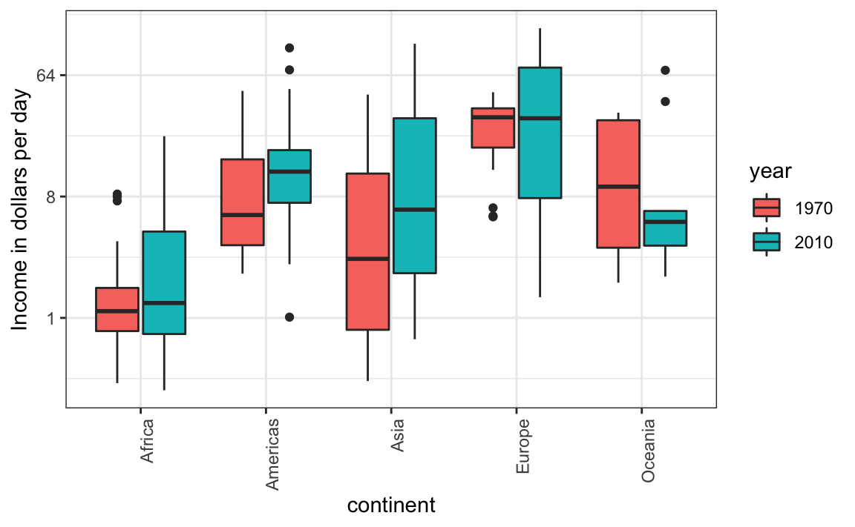
#6 Ease comparisons (7)
Use color
Box plot
Box plot

Slide 18
#7 Think of the color blind
#999999
#E69F00
#56B4E9
#009E73
#F0E442
#0072B2
#D55E00
#CC79A7
Example:
http://www.cookbook-r.com/Graphs/Colors_(ggplot2)/#a-colorblind-friendly-palette

Slide 19
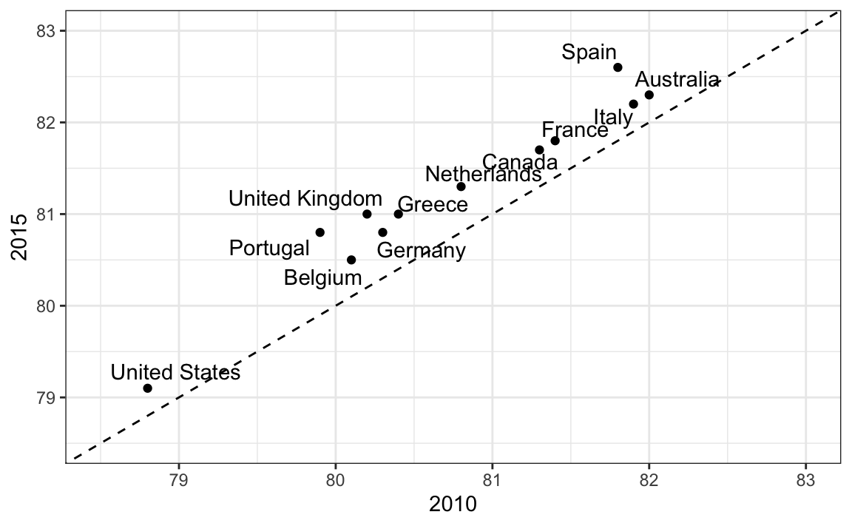
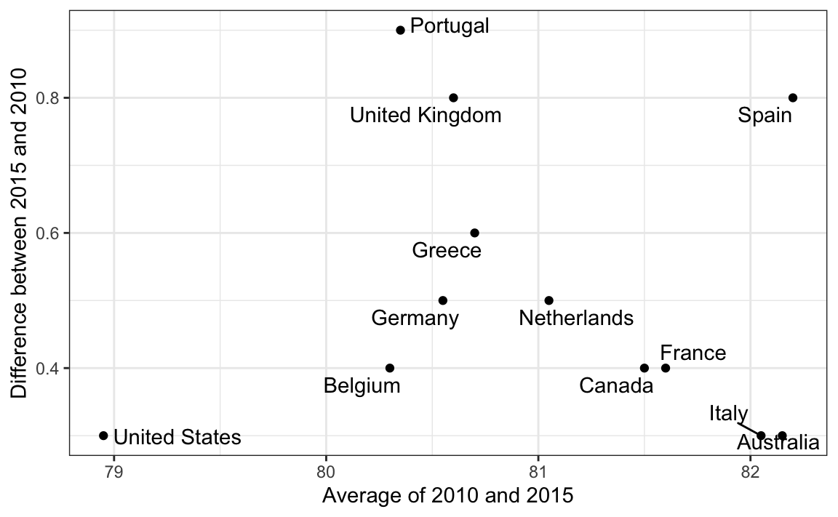
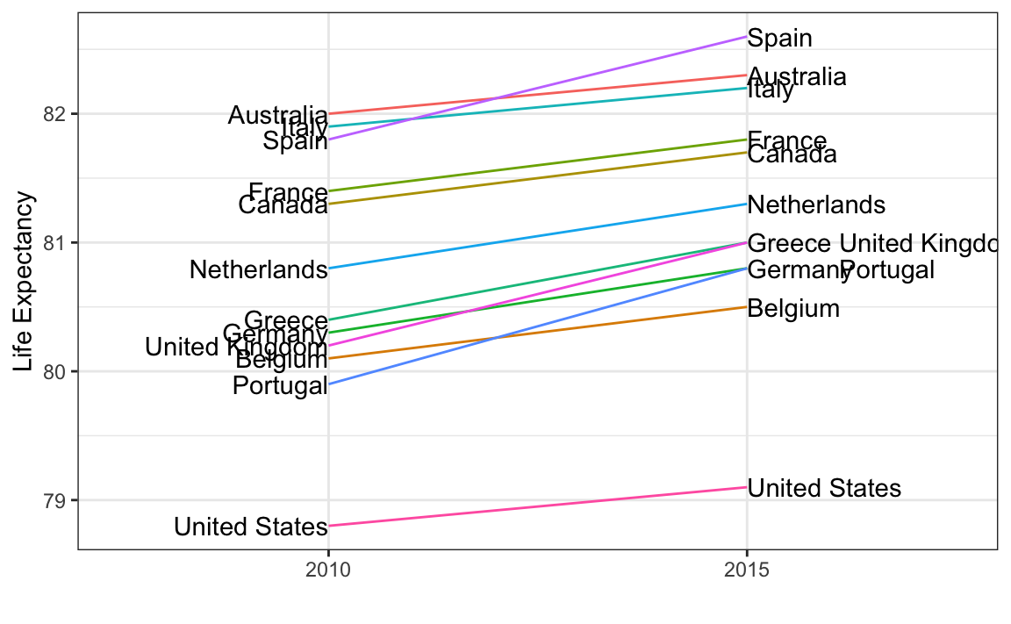
#8 Plots for two variables
Use scatterplots for two (continuous) variables, except:
Scatterplots
The central message is the difference between a couple of years
Variables of the same type but different time points
❌
✅
Bland-Altman plot
✅
Slope charts
Tukey mean-difference plot
Minus and average (MA) plot
Too many points make it useless

Slide 20
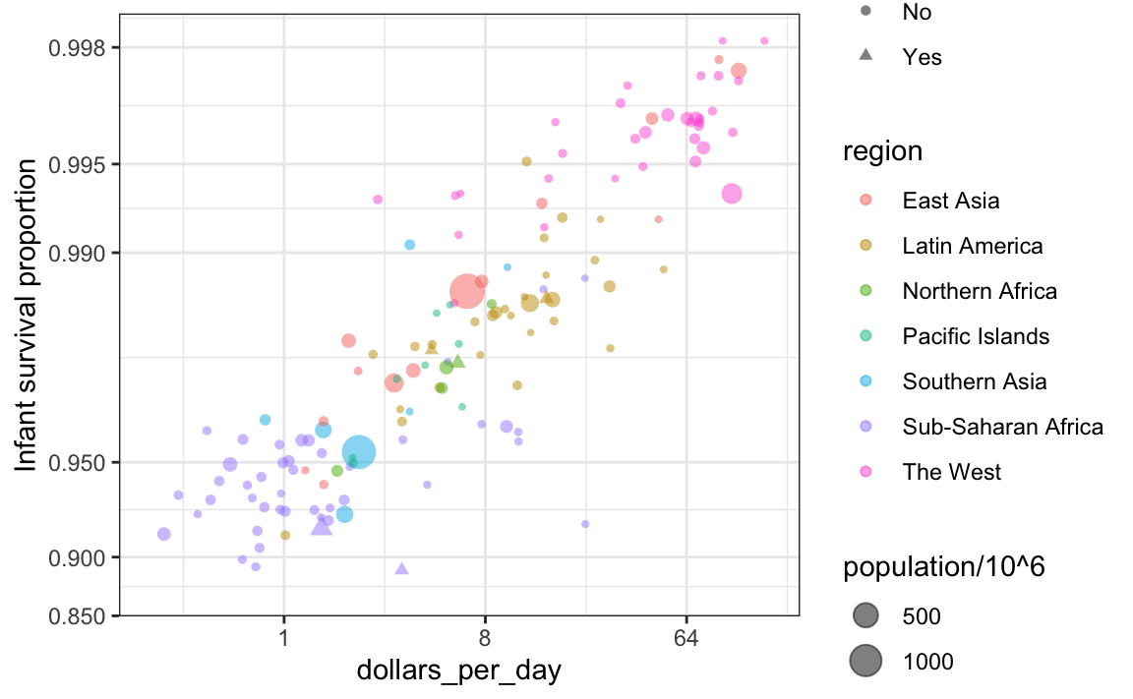
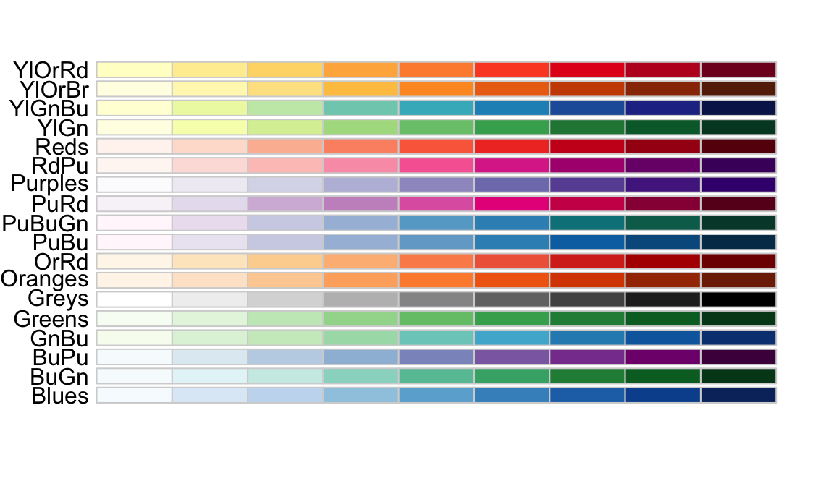
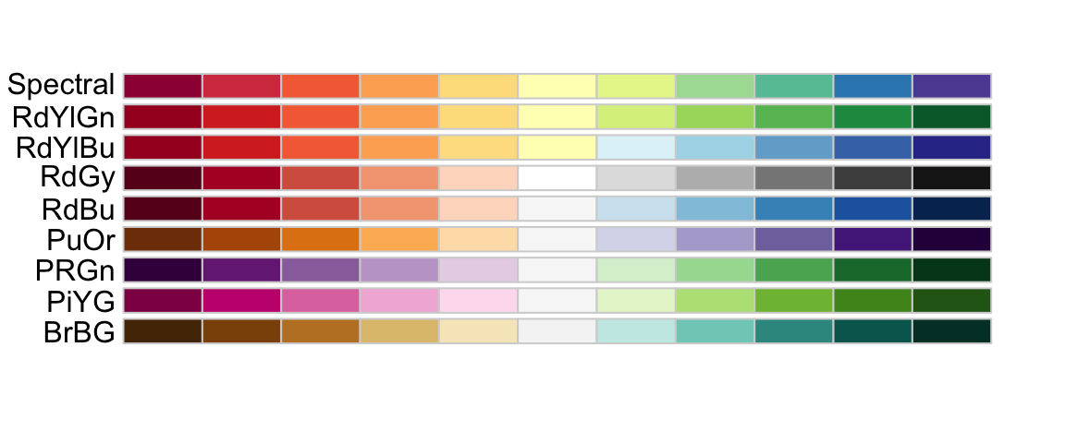
#9 Encoding a third variable
Categorical → color, shape
Numerical → color, intensity, size
Sequential colors →
high to low, low to high
Diverging colors →
lower to average to higher

Slide 21
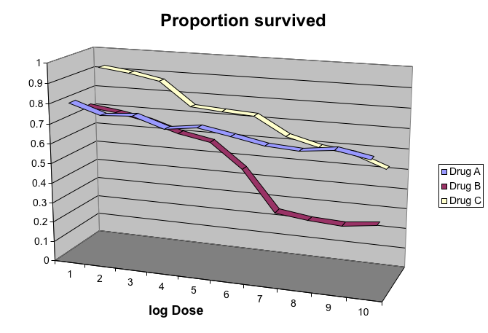
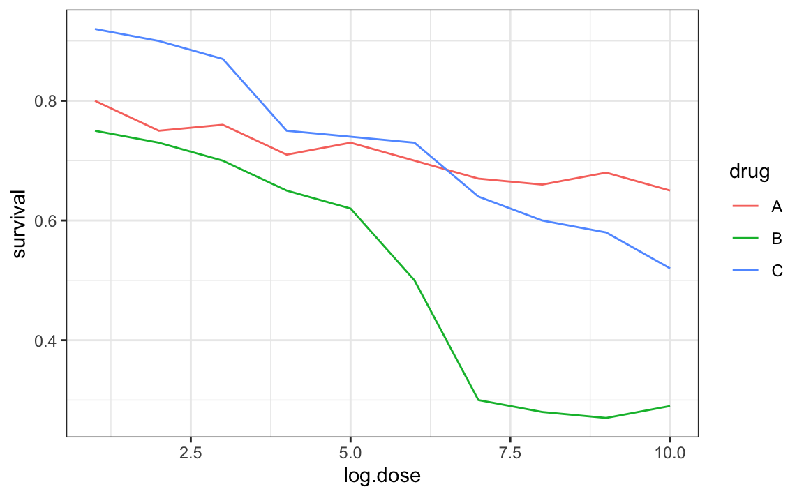
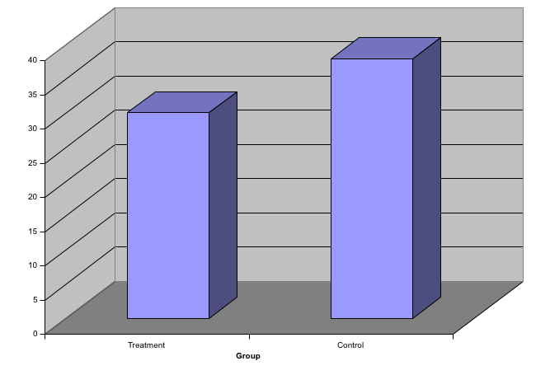
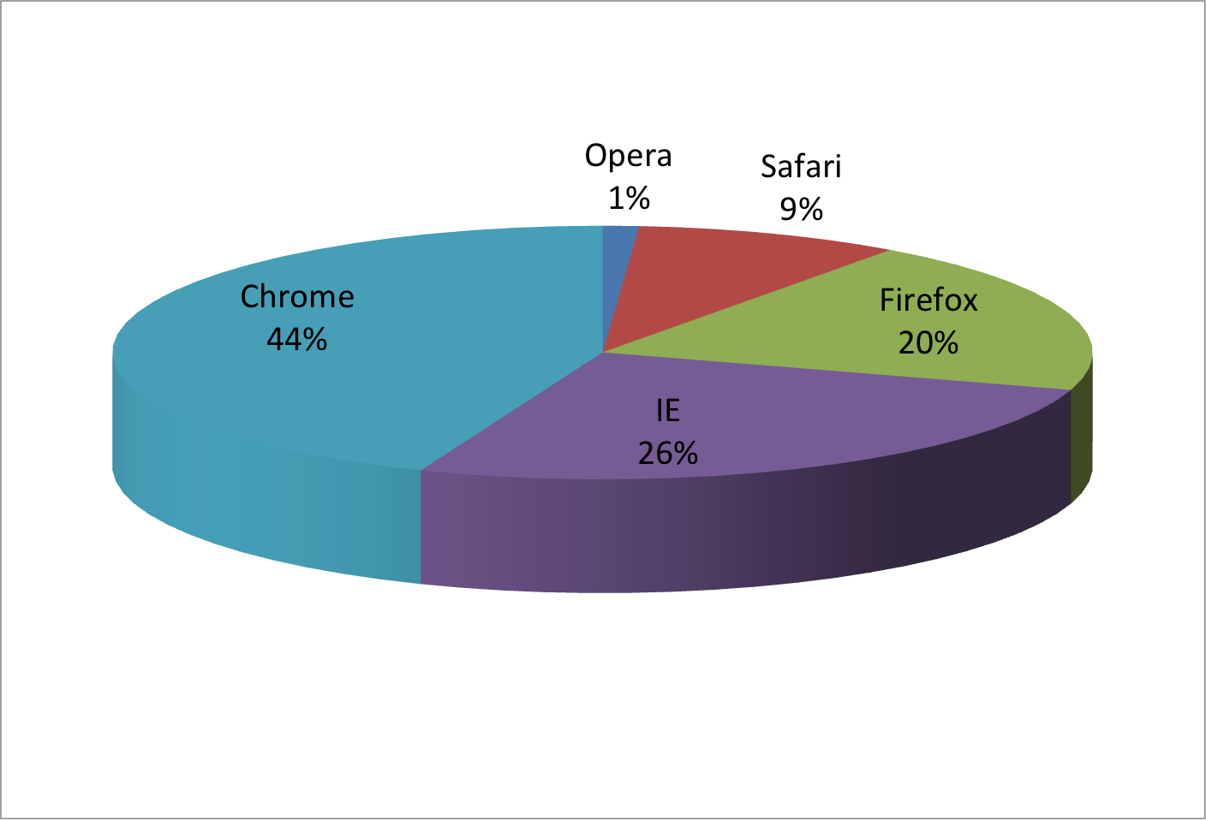
#10 Avoid pseudo-three-dimensional plots

Slide 22
#11 Avoid too many significant digits
Round the numbers
1 to <10 samples → 0 decimal
10 to <100 → 1 decimal
100 or more → 2 decimals
state | year | Measles | Pertussis | Polio
California | 1940 | 37.8826320 | 18.3397861 | 0.8266512
California | 1950 | 13.9124205 | 4.7467350 | 1.9742639
California | 1960 | 14.1386471 | NA | 0.2640419
California | 1970 | 0.9767889 | NA | NA
California | 1980 | 0.3743467 | 0.0515466 | NA
state | year | Measles | Pertussis | Polio
California | 1940 | 37.9 | 18.3 | 0.8
California | 1950 | 13.9 | 4.7 | 2.0
California | 1960 | 14.1 | NA | 0.3
California | 1970 | 1.0 | NA | NA
California | 1980 | 0.4 | 0.1 | NA
state | disease | 1940 | 1950 | 1960 | 1970 | 1980
California | Measles | 37.9 | 13.9 | 14.1 | 1 | 0.4
California | Pertussis | 18.3 | 4.7 | NA | NA | 0.1
California | Polio | 0.8 | 2.0 | 0.3 | NA | NA
Compare on columns rather than rows

Slide 23
#12 Know your audience
Our own exploratory data analysis
To convey a message to experts
To help tell a story to a general audience
✅
✅
❌
Example:
Exploration → log-transform data and then plot it
General audience → unfamiliar
a log-scale for the axis, instead of
log-transformed values
1000
100
10
1
3
2
1
0
log₁₀
Box plot + jitter plot

Slide 24

Figure formatting: A forgotten gem of a research paper
An good example from a publisher applicable for most publication
https://www.elsevier.com/authors/policies-and-guidelines/artwork-and-media-instructions
Disclaimer: I do not receive any sponsorship from this publisher. It is based on my personal experience only.

Slide 25
Never underestimate figure formatting
Careless formatting attracts more criticism (not limited to figure)
The simplest thing someone can do without an in-depth knowledge
While it may be a tricky-tech thing to some extent, you only need to learn it once.

Slide 26
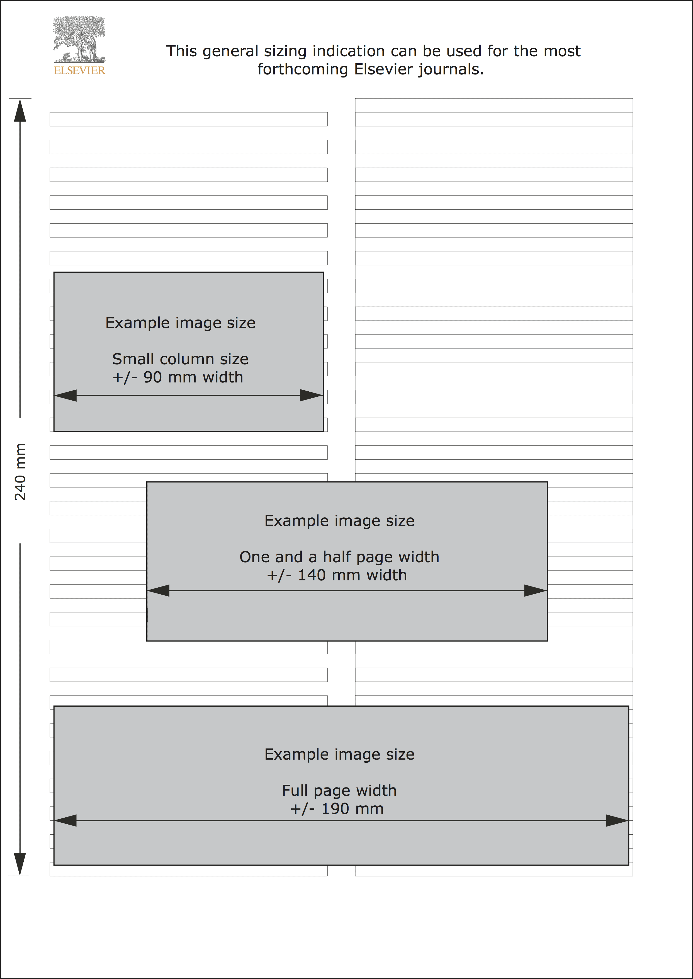
Sizing
TARGET SIZE | Image width | Pixels at 300 dpi | Pixels at 500 dpi | Pixels at 1000 dpi
Minimal size | 30 mm (85 pt) | 354 | 591 | 1181
Single column | 90 mm (255 pt) | 1063 | 1772 | 3543
1.5 column | 140 mm (397 pt) | 1654 | 2756 | 5512
Double column (full width) | 190 mm (539 pt) | 2244 | 3740 | 7480

Slide 27
File formats
Application/format | Extension | Accepted
Tagged Image File Format (TIFF) | TIF, TIFF | Recommended image format for halftones and bitmaps
Joint Photographic Experts Group (JPEG) | JPG, JPEG | Recommended image format for halftones
Encapsulated PostScript (EPS) | EPS | Recommended image format for vector-based images (*and embedded images)
Portable Document Format (PDF) | PDF | Recommended format for texts, notes, documents, vector-based images
Microsoft Word | DOC, DOCX | Recommended format for texts, notes, documents
Microsoft Excel | XLS, XLSX | Recommended format, typically charts when used for images, and tables for documents
Microsoft Powerpoint | PPT, PPTX | Recommended format for annotated images

Slide 28




Figure production
.eps
.tif
Use LZW
(Lempel-Ziv-Welch)
Compression
#1
#2
.svg
submit
#3
.ppt

Slide 29
Data Visualization in Practice
Originally proposed by Rafael Irizarry
Irizarry, R. A. (2020). Chapter 10: Data visualization in practice. In: Introduction to data science: Data analysis and prediction algorithms with R. https://rafalab.github.io/dsbook/data-visualization-principles.html

Slide 30

Download codes
https://github.com/herdiantrisufriyana/course_dataviz

Slide 31
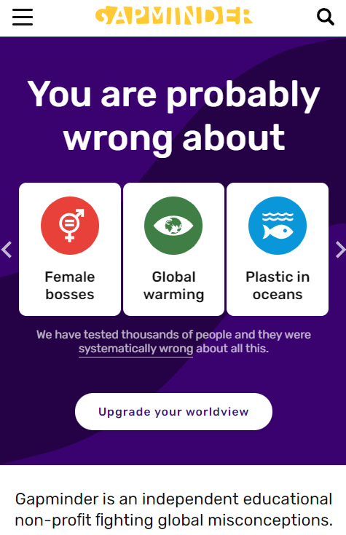
Data for visualization example
https://www.gapminder.org/
Download via “dslabs” R package

Slide 32
Demo

Slide 33
Take-home message
One figure, one central message, multiple arguments in panels
60% message, 30% translated to figure, 10% formatting
Data visualization → exploration → hypothesis generation
Don’t use the same dataset for hypothesis testing
May aggravate confirmatory bias
Learn R, a ‘new’ MS Excel

